Slide 1

Capital Budgeting as Knapsack Problem
Yijie Wu & Minqi Liao
12/15/2021

Slide 2
Agenda：
Business Background
Introduction to Knapsack Problem
Build an Optimization Model
Excel: Simplex LP Solver (for 200 DVs)
Python: GLPK/ Google OR-Tools (for 500 DVs)
Visualization
Hypothetical Clients
Benefits and Limitations
Supporting Files
Contribution

Slide 3
Business Background
A fast-growing e-commerce company is expanding their business. They now sell mainly snacks and everyday items online. Last month, their marketing department completed a three-month study on pet snacks and reported that pet snacks are highly profitable, with gross margin over 50%, and that there are fewer online sellers. The CEO foresaw this potential market as a major "blue ocean" for the next decade. So he decided to make selling pet snacks their long-term strategy. To keep cash flow healthy and reduce the cost of failure, the CEO planned to allocate $20,000 as the first phase of the budget.
Now, the operations team needs to choose which products to sell. They get cost information from supplies and calculate profits. Their goal is to select some high margin products from 500 products to maximize profits. We create a model to help them make their decision.

Slide 4

Problem Detail:
There are 500 products we can choose from, and the dataset includes SKU, COGS($) and profit($).
…
…
…
We have the budget of $20,000. Which products should we include if we wish to maximize the profit? And what’s the maximized profit?
Dataset reference: https://www.kaggle.com/tizianoparriani/kp01pisinger/version/1?select=knapPI_14_200_1000_1_items.csv

Slide 5
2. Introduction to Knapsack Problem
In the knapsack problem, you need to pack a set of items, with given values and sizes (such as weights or volumes), into a container with a maximum capacity. If the total size of the items exceeds the capacity, you can't pack them all. In that case, the problem is to choose a subset of the items of maximum total value that will fit in the container.
Reference: https://developers.google.com/optimization/bin/knapsack

Slide 6
3. Build an Optimization Model
Decision Variables: 500 products (select or not)
Objective: Maximize the profit
Constraints:
Total cost meets the budget limit $20,000
All DVs are binary
Assumption: Consistent quantity of each item selected. In this case, the quantity for each item is 1.
Optimization Algorithms:
Excel: Simplex LP Solver (for 200 DVs)
Python: GLPK/ Google OR-Tools (for 500 DVs)

Slide 7
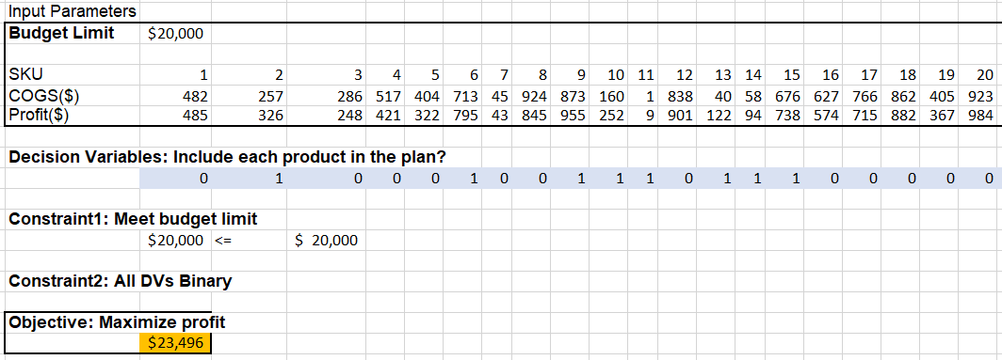
4. Excel: Simplex LP Solver (for 200 DVs)
The optimal profit for 200 DVs is $23,496.

Slide 8
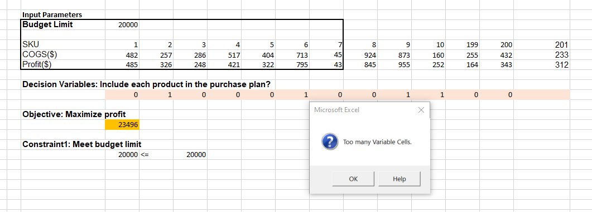
Limitation for Excel: no more than 200 DVs
We need to use Python for 500 DVs.

Slide 9
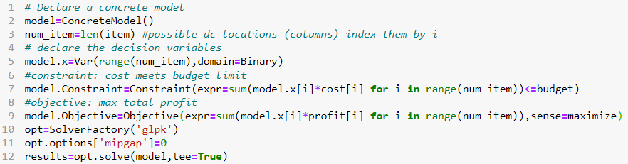
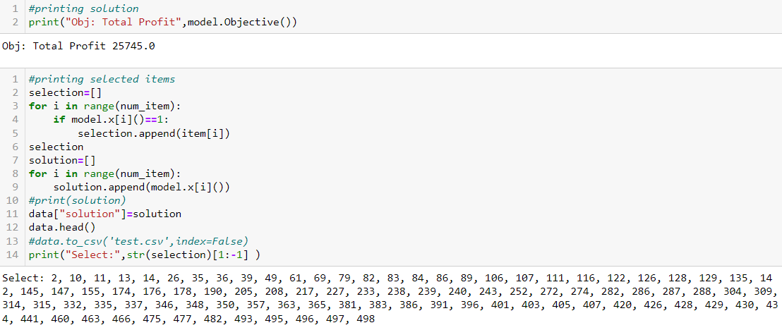
5. Python: Pyomo with GLPK (500 DVs)

Slide 10
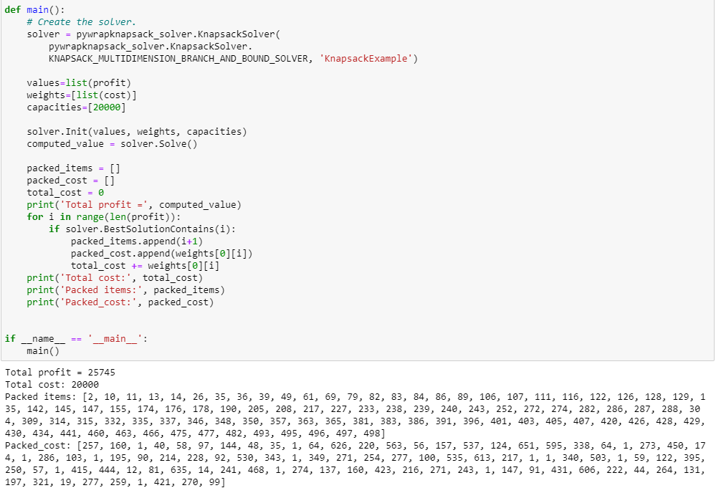
5. Python: Google OR-Tools (500 DVs)

Slide 11
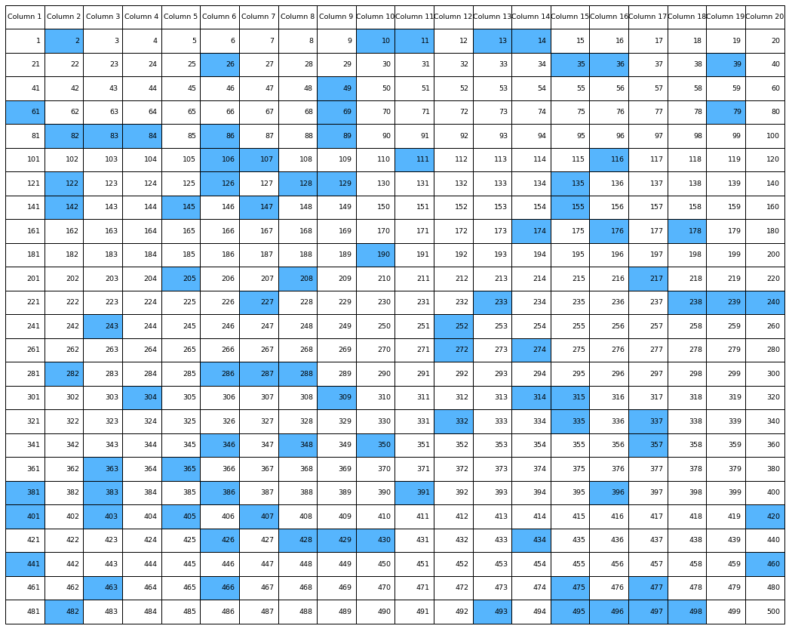
6. Visualization in Python

Slide 12
7. Hypothetical Clients
Anyone (organization or people) who wants to buy a group of products (commodities, stocks…) from a pool with a limited budget to maximize profits (or NPV, revenue …)，e.g.:
Purchasing managers who want to select products to maximize profits
Fund managers who want to make portfolios from a financial products pool using limited funds and to maximize IRR

Slide 13
8. Benefits and Limitations
Benefits:
Easy to use and understand
Visualization
Limitations:
Consistent quantity of each item selected (but the model can also be flexibly adapted if there are more realistic constraints based on different situations.)
Possible Improvements:
Imagine more realistic situations. E.g. if there are any conflicts between items (if I select item A, I cannot select item C); if there are more indicators that need to be maximized (maybe to allocate weights to each indicator and maximize the total)

Slide 14
9. Supporting Files
GB730 Final Project - Knapsack Problem.xlsx:
Introduction to the problem,
Solution for the problem with 200 DVs
Dataset for 500 records (prepared for python)
GB730 Final Project - Knapsack Problem.ipynb:
Two approaches solving the problem with 500 DVs
Visualization

Slide 15
10. Contribution
Yijie found the data set and built the model in Excel. Minqi wrote python code in Jupyter Notebook. Yijie and Minqi contributed to drawing slides together.

